Slide 1
Agile Methodology in Practice
How A Traditional Software House Uses Agile Development Methodology to Deliver Software Products efficiently

Slide 2
Outlines
Recap
A modern Software house
People
Process
Case study
Orchestra…
In a nutshell
Classes of Software Houses
Questions?

Slide 3
Recap
What?
A flexible development process in which:
Individuals are valued more than processes
Customer is the part of building team
Planning is encouraged; plans are discouraged
Bottlenecks are prevented
Why?
Because “tabdeeli”
How?
The rest of the presentation explains just that
Kindly read 12 principles of Agile manifesto (again and again)

Slide 4
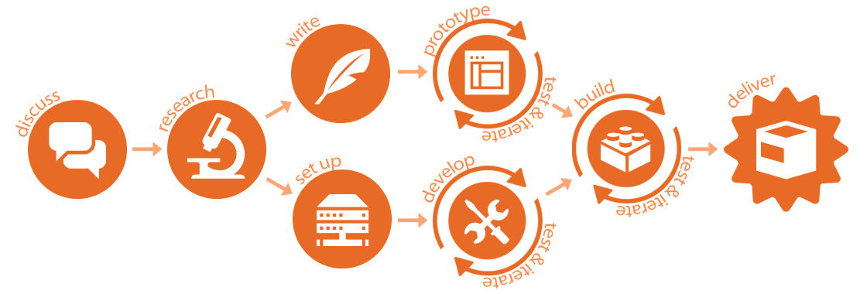
A modern Software house

Slide 5
People
An agile team can be broken down as:
1 product owner
1 analyst
1 designer
Up to 6 engineers handling development, testing and deployment
1 team member acts as facilitator, a.k.a. Scrum master
No hierarchy

Slide 6
Process
Bottlenecks. What exactly are those?
Are you Agile or just following rituals?
Are you Agile or ad-hoc?
The difference is continuous planning, because:
What works for me may not work for you
What works for me may not work for me in another project
What works for me today may not work for me tomorrow in the same project
Sprinting

Slide 7
Case study – Aao TB Mitao
Domain: public health
Scale: nation-wide
Scope: Tuberculosis
7 projects; 1 year; change ratio: 2/5 to 3/5
A web app, 2 mobile apps and a reporting dashboard
Outcome: 6 our of 7 projects delivered on time by a team of 13 people

Slide 8
An orchestra… of technologies and tools
Planning
Version Control
Build management
Versioning
Automated testing
Code quality
Issue tracking
Documentation
Deployment
Sprint planning, sprint and retrospective
Scaling

Slide 9
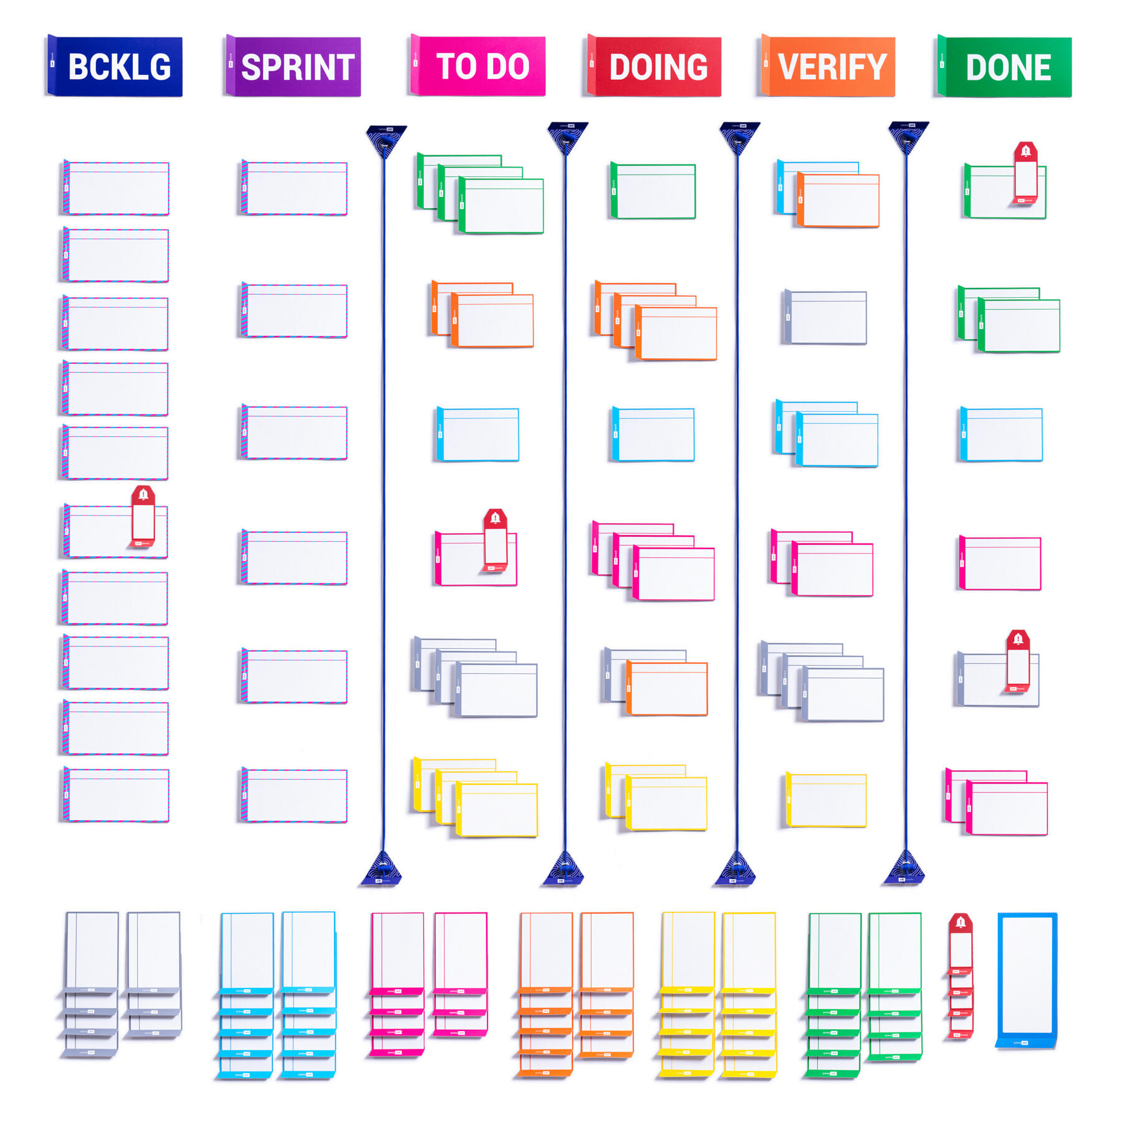

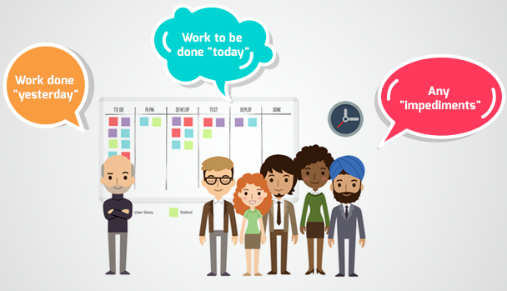
Planning
Meetings: Standups
Communication: Slack
Commitments: Gmail
Scrum board: JIRA

Slide 10

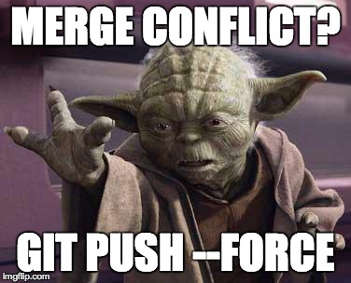
Version Control
Version control systems allow us to manage changes to code and preserve all the revisions
Github
Single repository per app
Github flow: protected master/test/production branches; feature branches and code mergers
Code reviews
Handling merge conflicts

Slide 11
Build Management
Build managers make it easy to organize dependencies, compile, build and package code into an executable artifact.
Gradle for Android apps
Maven for Web app

Slide 12
Versioning
Versioning is the process of assigning unique version names version numbers to software builds.
Build Number (for Android)
Semantic Versioning (a.k.a. SemVer)
Major
Minor
Micro (maintenance)
Releases: Pre-Alpha, Alpha, Beta, Production
Separate version for each app
Concept of SNAPSHOTS

Slide 13
Automated Testing
Test automation ensures that every feature is tested manually only once.
Junit: unit testing
Postman: API testing
Selenium: performance testing

Slide 14
Code Quality
Code quality check eliminates bad code practices, increases readability, prevents security holes and increases runtime performance.
Manual code reviews before merge
SonarQube before commit
Why? Because of weak understanding of:
Design patterns
OOP concepts
Data structures
Data querying
Test-driven development

Slide 15
Issue Tracking
Issue tracking means managing issues, which may be bugs, change requests and new feature requests.
Protocol:
Discussion > Email > Update documents > Jira > Sprint planning
Impact analysis, priority, activity type, estimates and progress update
Tools:
Jira
Email

Slide 16
Documentation
Rules:
Zero documentation is recipe for failure
Documenting everything is waste of time
Write-only documents are prohibited
Documentation levels and protocols:
Confluence
Jira
Google drive
In-code

Slide 17
Deployment
In order to avoid deployment confusion, it is vital to keep the environment consistent.
Developer’s machine: frequently changed (without notice)
Test serer: frequently reset
Demo server: periodically reset, production clone
Production server: most stable, 24/7/365
Virtualization (VMWare/VirtualBox) vs Containerization (Docker)

Slide 18
Sprint, Sprint Planning and Retrospective
Sprint planning is a team meeting with mandatory attendance. The team decides what gets done in coming sprint.
Two to three-week long sprints, starting on Tuesdays and ending on Fridays.
Once a sprint starts, the objectives cannot change.
Sprint retrospective talks about what we’ve achieved and lessons learnt.
Outcome of a sprint is a working version of software.

Slide 19
In a nutshell
Client asks a feature on email
Business analyst performs analysis and the feature is approved
Client creates a ticket on Jira
Scrum master picks the ticket and converts into a user story
User story is converted into tasks and put on backlog on scrum board
Tasks are picked in sprint planning meeting
Designer provides mockup/wireframe
Developers write code, perform unit testing and linting, and commit on local branch
Lead programmer reviews code and merges into master branch
The code is built and artifacts are created
Artifacts are deployed automatically on test environment
Quality Assurance team performs testing and approves the build
Build is deployed and validated to production environment a day before end of sprint
Release notes are prepared and respective tasks are closed

Slide 20
Classes of Software Companies
Continuous Delivery Maturity Model

Slide 21
 | Culture & Organization | Design & Architecture | Build & Deploy | Quality Assurance | Reporting
Baseline | Defined process Prioritize client WBS and predefined timelines | Consolidated technologies Modular architecture | Versioned code base Scripted builds Documented manual deployments | Automated unit tests Separate testing environment Issue tracking | Manual reporting Qualitative quality metrics
Beginner | One backlog per team Adopt basic Agile process Shared incentives/penalty on success/failure | Version control DB Change management Library management File-based configuration | Scheduled builds (CI) Dedicated build server Scripts to automate deployment | Automated integration tests Code reviews | Automated code analysis reports Quantitative quality metrics
Intermediate | Prioritize members Inter-team collaboration Common change process Decentralized decisions Dedicated Dev & Ops Introduce performance metrics | Consistent branching structure Platform-level configuration management Feature hiding Integrated issue tracking | Build storage Manual tagging/versioning Build once, deploy many Basic deployment pipeline (CD) | Performance tests Some automated acceptance tests Peer code reviews | Traceability built into pipeline Report history storage Live dashboards
Advanced | Dedicated specialists for each tool Continuous improvement (Kaizen/Six Sigma) | Microservice architecture Artifact management | Zero downtime for deployment (CD) Institutionalized Build/deploy process | Automated security tests Disaster recovery | Graphics as a service Trend analysis Data mining
Expert | Prioritize teams Zero rollbacks, always move forward No process bypasses Cross functional teams | Complete Agile process | Zero touch continuous deployment Build bakery | Expected business value verification Continuous optimization of processes | AI-based decision support

